Slide 1
Cryptocurrency trading – tracking and decision support
Tyrone Hunt

Slide 2
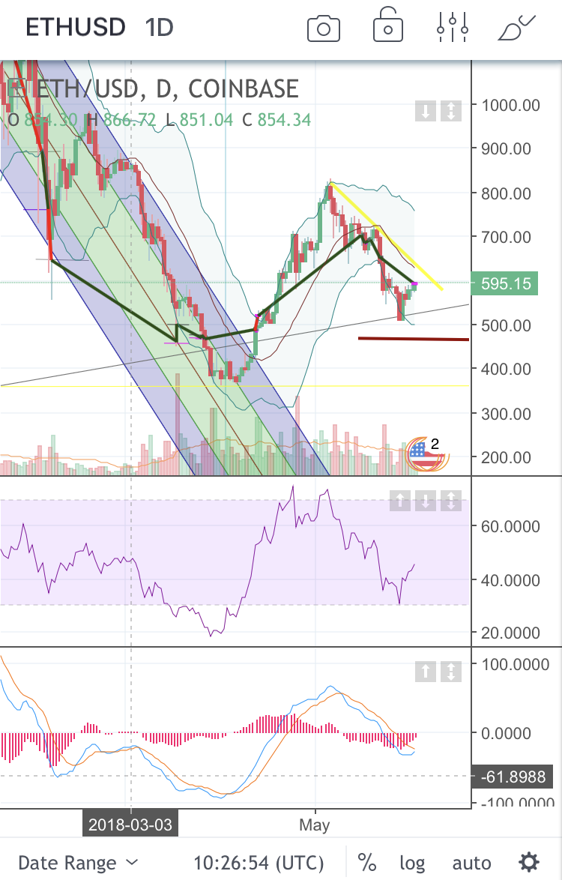
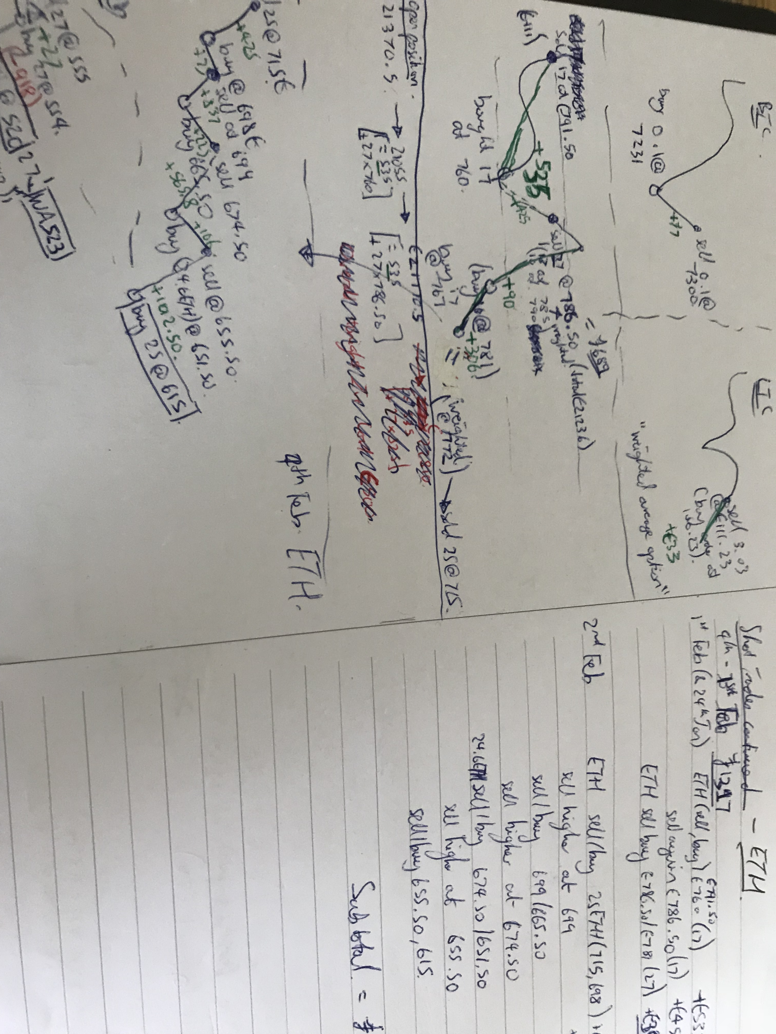
What’s the problem?
Unknown ROI
Risk exposure not properly understood
Data in multiple places
Time consuming

Slide 3
the objective
SCOPE IS…
Calculate BTC balances, ROI and performance against baseline scenarios
Investigate which common trading signals are significant and in what scenarios
SCOPE IS NOT…
All cryptocurrencies
A full trading strategy
Trade advice! (pretty sure I need that in for legal reasons)
FOR EXAMPLE:
Trade Signal | 1h | 4h | 1d | 1w
RSI
MACD
EMA
VOLUME
BOLLINGER B.
Complicated by:
Combinations
Variations
Significance of trigger
Interpretations
Non-algorithmic affects

Slide 4
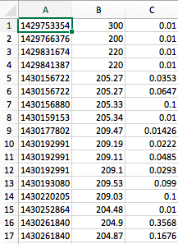
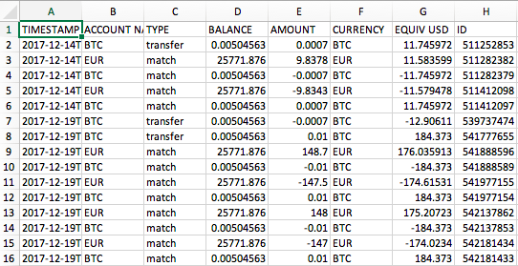
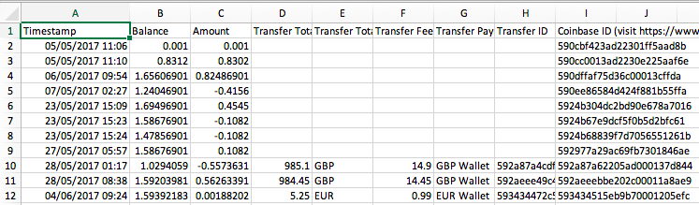
Data and Analysis
BTC Price / Volume
Coinbase / GDAX Trades
Clean / classify / merge trade and price data
Calculate trade indicators
Run statistical inference tests
Run back-test simulations based on proposed trade rules

Slide 5

Customer identification for property services start-up
Tyrone Hunt

Slide 6
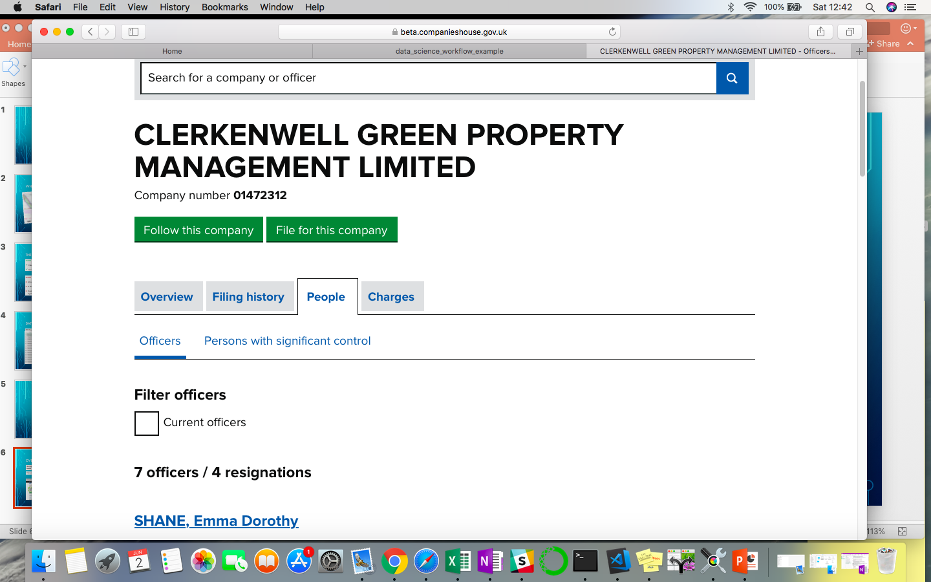
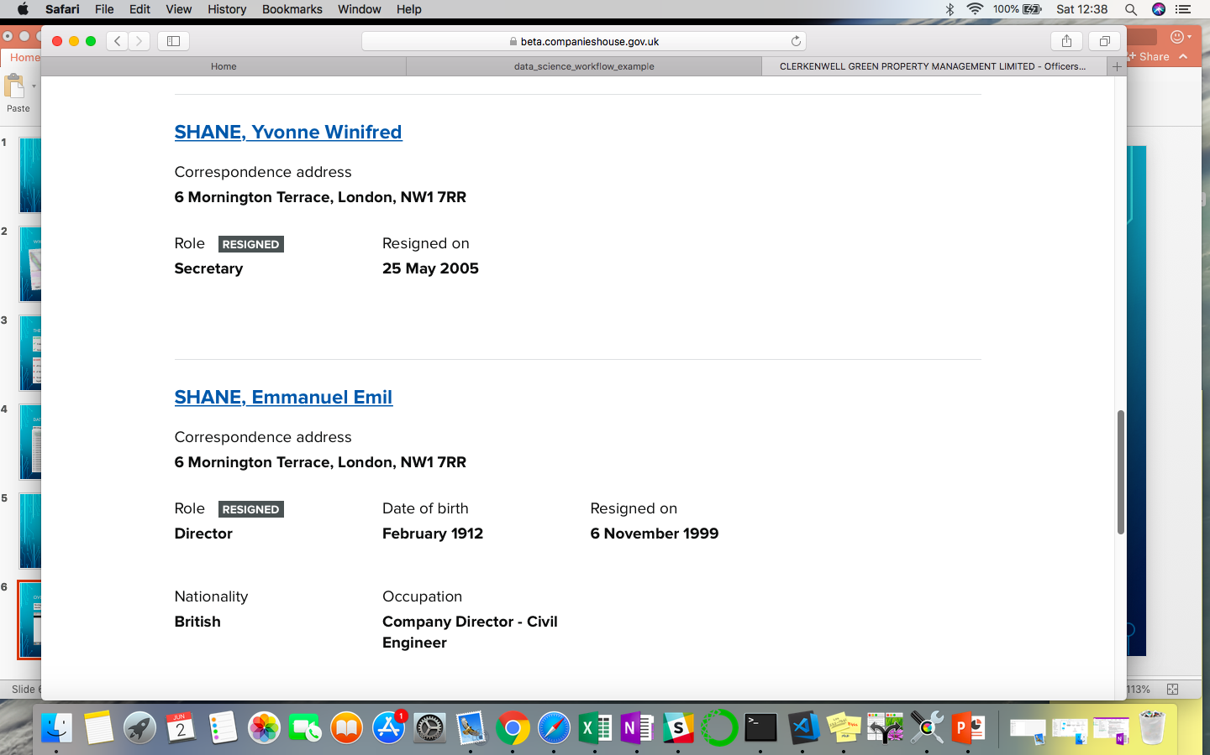
Overview
Startup has a value proposition that aims to provide better service to share-of-freehold companies. This means it needs to identify potential customers…
Can we use data science to scrape ‘Companies House’ data and filter according to rules?

Slide 7
Data categorisation for graphical database start-up
Tyrone Hunt

Slide 8
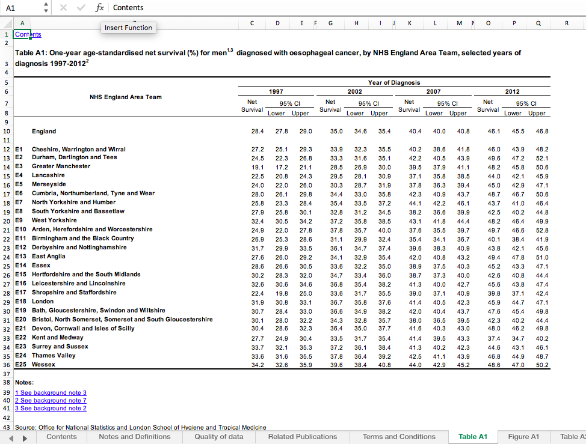
Overview
Startup has a value proposition that uses machine learning and graph databases to make it easy for journalists and civil servants to quickly discover important information
ONS - Cancer survival rates by hospital - UK
Can we automatically categorise data to reduce manual cleaning effort required?

